Slide 1
A local /bin Directory
Adding a local directory for executable files.
Adding local directories for python modules
Hamilton Python Users Group
11 March 2019
Ian Stewart

Slide 2
$PATH - /usr/local/bin/
$ echo $PATH
Bash: /usr/local/sbin:/usr/local/bin:/usr/sbin:/usr/bin:/sbin:/bin:/usr/games:/usr/local/games:/snap/bin:
$

Slide 3
Write a python program
$ touch my_python_prog
$ nano my_python_prog
$ cat my_python_prog
#!/usr/bin/env python3
#!
print("my_python_prog prints out this message")
$ ls -l my_python_prog
-rw-rw-r-- 1 ian ian 75 Mar 10 17:09 my_python_prog

Slide 4
Run Program
$ python3 my_python_prog
my_python_prog prints out this message
$ my_python_prog
my_python_prog: command not found
$ ./my_python_prog
bash: ./my_python_prog: Permission denied
$ sudo ./my_python_prog
[sudo] password for ian:
sudo: ./my_python_prog: command not found

Slide 5
Use chmod +x to run program. But...
$ chmod +x my_python_prog
$ ls -l my_python_prog
-rwxrwxr-x 1 ian ian 75 Mar 10 17:09 my_python_prog
$ ./my_python_prog
my_python_prog prints out this message
$ mkdir another_folder
$ cd another_folder
$ ./my_python_prog
bash: ./my_python_prog: No such file or directory

Slide 6
Need priv to copy to /usr/local/bin/
$ ls -l /usr/local/
drwxr-xr-x 2 root root 4096 May 15 2018 bin
...snip...
$ ls -l my_python_prog
-rwxrwxr-x 1 ian ian 75 Mar 10 17:09 my_python_prog
$ cp my_python_prog /usr/local/bin
cp: cannot create regular file '/usr/local/bin/my_python_prog': Permission denied
$ sudo cp my_python_prog /usr/local/bin
[sudo] password for ian:
$

Slide 7
Try out program in/usr/local/bin
$ ls -l /usr/local/bin/my_python_prog
-rwxr-xr-x 1 root root 75 Mar 10 19:40 /usr/local/bin/my_python_prog
$ ls -l my_python_prog
-rwxrwxr-x 1 ian ian 75 Mar 10 17:09 my_python_prog
$ mv my_python_prog my_python_prog_local
$ ls -l my_python_prog_local
-rwxrwxr-x 1 ian ian 75 Mar 10 17:09 my_python_prog_local
$ my_python_prog
my_python_prog prints out this message

Slide 8
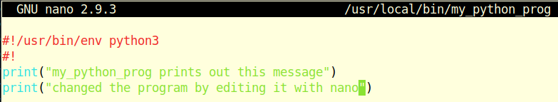

Program runs OK. Unable to modify program...
$ my_python_prog
my_python_prog prints out this message
$ nano /usr/local/bin/my_python_prog

Slide 9
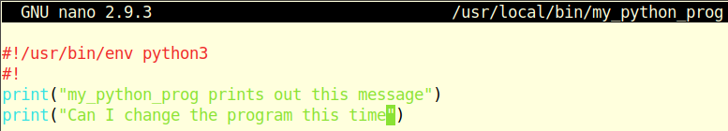
Need priv to modify my program in /usr/local/bin/
$ my_python_prog
my_python_prog prints out this message
$ sudo nano /usr/local/bin/my_python_prog
$ my_python_prog
my_python_prog prints out this message
Can I change the program this time

Slide 10
Examine the accounts .profile file...
$ cd ~/
$ cat .profile
# ~/.profile: executed by the command interpreter
# for login shells.
# This file is not read by bash(1), if
# ~/.bash_profile or ~/.bash_login exists.
... snip...
# set PATH so it includes user's private bin if it
# exists
if [ -d "$HOME/bin" ] ; then
PATH="$HOME/bin:$PATH"
fi

Slide 11
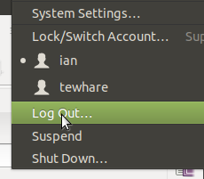
Make a bin folder. Move program to bin folder. Logout of account...
$ mkdir bin
$ mv my_python_prog_local bin/my_python_prog_local
$ ls -l bin/my_python_prog
-rwxrwxr-x 1 ian ian 75 Mar 10 20:33 bin/my_python_prog_local

Slide 12
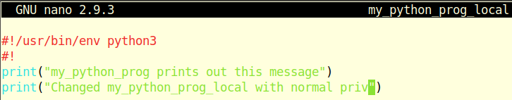
Log back in to account. Run / Modify program...
$ echo $PATH
bash: /home/ian/bin:/usr/local/sbin:/usr/local/bin:...snip...
$ my_python_prog_local
my_python_prog prints out this message
$ cd bin
$ nano my_python_prog_local

Slide 13
Get out of bin folder. Can run modified program...
$ cd ~/
$ my_python_prog_local
my_python_prog prints out this message
Changed my_python_prog_local with normal priv

Slide 14
Create bin-x sub-directories off bin...
$ cd ~/
$ cd bin
$ ls -l
total 4
-rwxrwxr-x 1 ian ian 129 Mar 10 20:46 my_python_prog_local
$ mkdir bin-python
$ mkdir bin-bash
$ mkdir bin-development
$ ls
bin-bash bin-development bin-python my_python_prog_local

Slide 15
Move program to sub-directory. Fails...
$ my_python_prog_local
my_python_prog prints out this message
Changed my_python_prog_local with normal priv
$ mv my_python_prog_local bin-python/
$ ls -l bin-python
total 4
-rwxrwxr-x 1 ian ian 129 Mar 10 20:46 my_python_prog_local
$ my_python_prog_local
bash: /home/ian/bin/my_python_prog_local: No such file or directory

Slide 16
Add code to .profile. Then Logout and Login...
if [ -d "$HOME/bin" ]
then
for file in ${HOME}/bin/bin-*
do
if [ -d "$file" ]
then
PATH="$file:$PATH"
fi
done
fi

Slide 17
$PATH after logout / login...
$ echo $PATH
bash: /home/ian/bin:/usr/local/sbin:/usr/local/bin:/...
$# Equivalent to Logout / Login
$ source ~/.profile
$ echo $PATH
bash: /home/ian/bin/bin-python:/home/ian/bin/bin-development:/home/ian/bin/bin-bash:/home/ian/bin:/usr/local/sbin:/usr/local/bin:/...

Slide 18
Does program run from bin/bin-python/
$ cd ~/
$ ls bin/bin-python/
my_python_prog_local
$ my_python_prog_local
my_python_prog prints out this message
Changed my_python_prog_local with normal priv

Slide 19
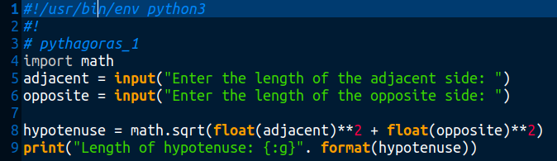
pythagoras_1 program in bin/bin-python​/

Slide 20
chmod + x to run from bash prompt...
$ pythagoras_1
bash: /home/ian/bin/bin-python/pythagoras_1: Permission denied
$ ls -l bin/bin-python/
total 8
-rwxrwxr-x 1 ian ian 129 Mar 10 20:46 my_python_prog_local
-rw-rw-r-- 1 ian ian 294 Mar 10 22:45 pythagoras_1
$ chmod +x bin/bin-python/pythagoras_1
$ ls -l bin/bin-python/
total 8
-rwxrwxr-x 1 ian ian 129 Mar 10 20:46 my_python_prog_local
-rwxrwxr-x 1 ian ian 294 Mar 10 22:45 pythagoras_1

Slide 21
Program now runs from $ prompt
$ cd ~/
$ pythagoras_1
Enter the length of the adjacent side: 5
Enter the length of the opposite side: 12
Length of hypotenuse: 13

Slide 22
Summary, so far...
Python, bash, etc. scripts can be run as bash commands.
Scripts are normally in folder /usr/local/bin/
Scripts need priv to copy there and to edit.
Many computers have only one user.
Can create a /home/USER/bin/ folder.
.profile adds ~/bin to $PATH
Scripts in ~/bin upon having chmod +x can be executed from any folder in the User’s account.
Scripts in sub-directories of ~/bin will not execute.
Modify .profile to support some sub-directories of ~/bin running python or bash scripts.

Slide 23
Continue with...
Sub-folders as executable.
Python modules in sub-directories.
$PYTHONPATH to local directory.

Slide 24
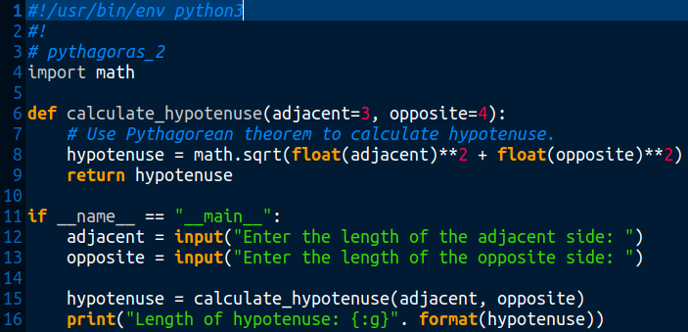
Pythagorean theorem using a function...

Slide 25
Run pythagoras_2
$ python3 bin/bin-python/pythagoras_2
Enter the length of the adjacent side: 5
Enter the length of the opposite side: 12
Length of hypotenuse: 13

Slide 26
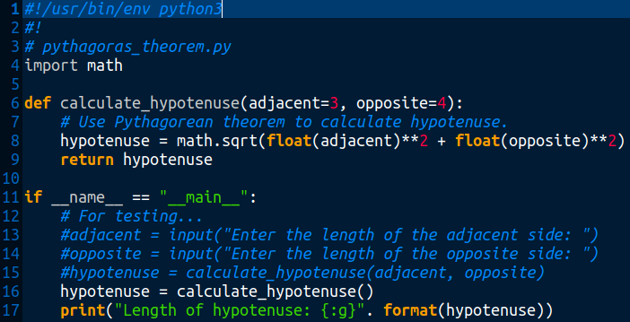
Convert program with function to a module

Slide 27
pythagoras_theorem.py module can be run on its own to test it works OK...
$ python3 bin/bin-python/pythagoras_theorem.py
Length of hypotenuse: 5

Slide 28
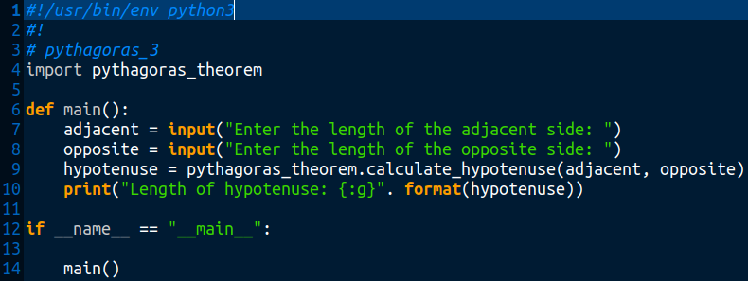
Create pythagoras_3 that calls pythagoras_theorem.py module
Both pythagorus_3 and pythagorus_theorem.py files are in ~/bin/bin-python.

Slide 29
Run pythagoras_3
$ ls bin/bin-python/pythagoras_3 -l
-rw-rw-r-- 1 ian ian 386 Mar 10 23:24 pythagoras_3
$ chmod +x bin/bin-python/pythagoras_3
$ ls bin/bin-python/ -l
-rwxrwxr-x 1 ian ian 386 Mar 10 23:24 pythagoras_3
-rw-rw-r-- 1 ian ian 599 Mar 10 23:36 pythagoras_theorem.py
$ pythagoras_3
Enter the length of the adjacent side: 20
Enter the length of the opposite side: 21
Length of hypotenuse: 29
Does not require execute status

Slide 30
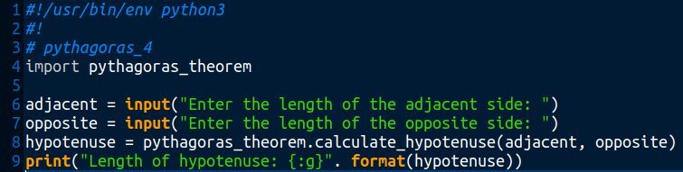
Run pythagoras_4 no if __name__=='__main__':
$ pythagoras_4
Enter the length of the adjacent side: 11
Enter the length of the opposite side: 60
Length of hypotenuse: 61

Slide 31
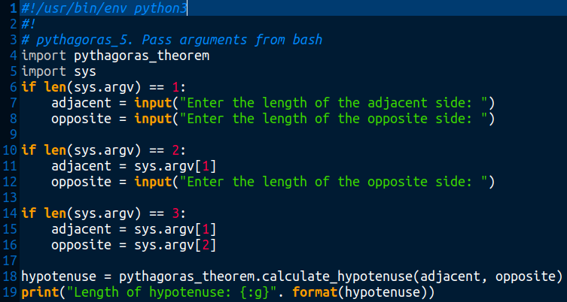
pythagoras_5
Bash passes arguments

Slide 32
pythagoras_5 – passing arguments
$ pythagoras_5
Enter the length of the adjacent side: 9
Enter the length of the opposite side: 40
Length of hypotenuse: 41
$ pythagoras_5 9
Enter the length of the opposite side: 40
Length of hypotenuse: 41
$ pythagoras_5 9 40
Length of hypotenuse: 41

Slide 33
Create a python library off bin-python
$ cd bin
$ cd bin-python
$ ls pythagoras_theorem.py -l
-rw-rw-r-- 1 ian ian 599 Mar 10 23:36 pythagoras_theorem.py
$ mkdir pylib
$ mv pythagoras_theorem.py pylib/
$ ls -l pylib/
total 4
-rw-rw-r-- 1 ian ian 599 Mar 10 23:36 pythagoras_theorem.py

Slide 34
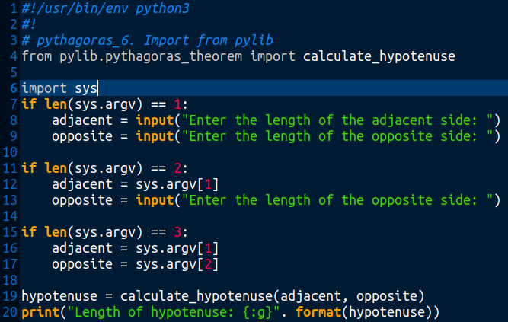
pythagoras_6 import from pylib
$

Slide 35
pythagoras_6
$ pythagoras_6 6 8
Length of hypotenuse: 10
$ tree bin
bin
├── bin-bash
├── bin-development
└── bin-python
├── pythagoras_6
├── pylib
│ ├── __pycache__
│ │ └── pythagoras_theorem.cpython-36.pyc
│ └── pythagoras_theorem.py
│

Slide 36
Create a separate local python library directory
$ ~/
$ mkdir lib
$ cd lib
$ mkdir python
$ cd ~/
$ nano .profile
...
# Allow python modules to reside in local library.
export PYTHONPATH="$HOME/lib/python:$PYTHONPATH"
Logout and log back in.

Slide 37
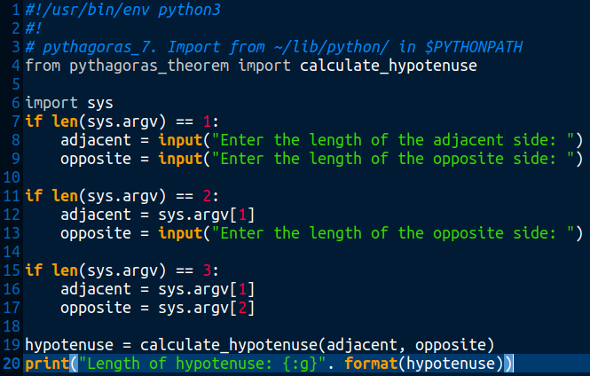
pythagoras_7 – local library

Slide 38
Pythagoras_7 with updated $PYTHONPATH
$ pythagoras_7 6 8
Length of hypotenuse: 10
$ tree bin
/home/ian/
├── bin
│ ├── bin-bash
│ ├── bin-development
│ └── bin-python
│ └── pythagorus_7
├── lib
│ └── python
│ └── pythagoras_theorem.py
│

Slide 39
Comparison of imports...
pythagoras_6 with module in ~/bin/bin-python/pylib/
from pylib.pythagoras_theorem import calculate_hypotenuse
pythagoras_7 with module in ~/lib/python/
from pythagoras_theorem import calculate_hypotenuse
Call is the same...
hypotenuse = calculate_hypotenuse(adjacent, opposite)

Slide 40
__end__

